Slide 1

Flower recognition
Empirical Research 2019/2020
Andrea Rafanelli
4815168

Slide 2
Agenda
1
DATASET AND DATA PREPROCESSING
2
MODEL CREATION
3
MODEL IMPROVEMENTS
4
WHAT ELSE?
5
CONCLUSION
2

Slide 3
Section 1
DATASET AND DATA PREPROCESSING

Slide 4

Dataset
GOAL:
Creation of a model able to classifies flower images into the five categories.
1
4323 images
2
Five categories:
dandelion, rose, sunflower, daisy and tulip.
3
240x320 pixels
Empirical research 2019/2020
4

Slide 5
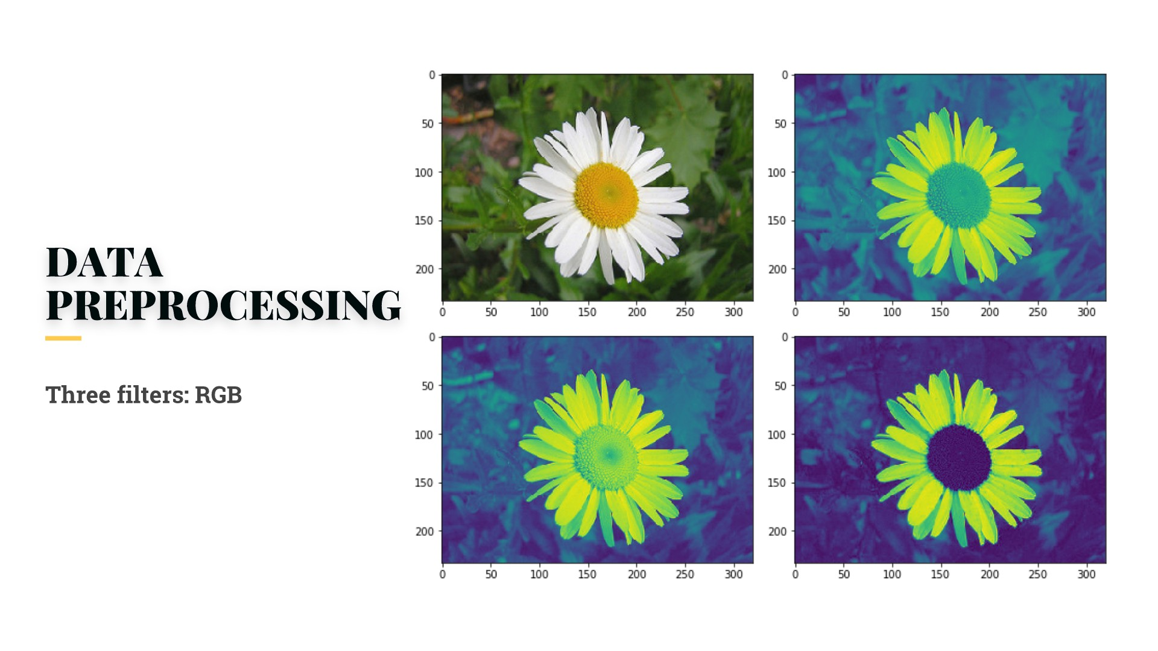
Data preprocessing (1)
THREE FILTERS: RGB
channels = ['r','g','b']
def plot_rgb (image):
for i, color in enumerate(channels):
plt.imshow(image[:,:,i])
plt.show()
Empirical research 2019/2020
5

Slide 6
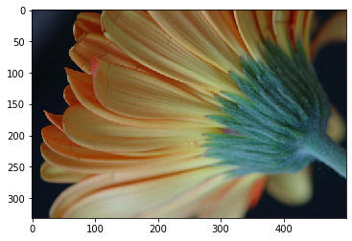
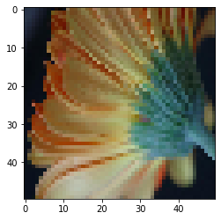
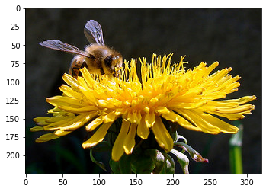
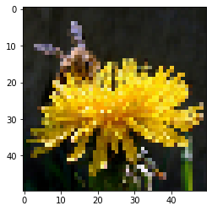
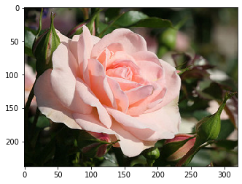
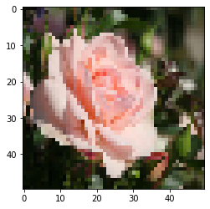
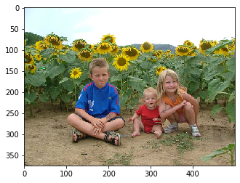
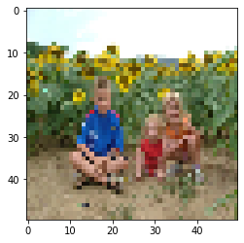
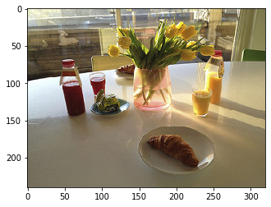
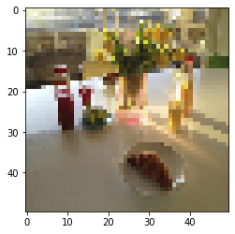
Data preprocessing (2)
FROM 240x320 TO 90x90
NORMALIZATION OF THE PIXELS
Empirical research 2019/2020
6

Slide 7

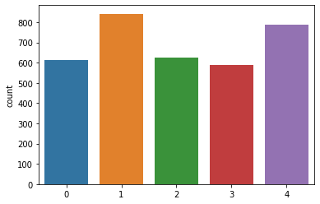

Data preprocessing (3)
3458 images in the training set
865 images in the test set
Are the two balanced?
TEST SET
18% daisy
24% dandelion
18% rose
17% sunflower
23% tulip
TRAINING SET
18% daisy
24% dandelion
18% rose
17% sunflower
23% tulip
Empirical research 2019/2020
7

Slide 8
Section 2
MODEL CREATION

Slide 9
Starting with the simplest one
Hidden layer activation: Relu
Weight initialization: 'He initialization'
Because of the non-linearity of the Relu activation function.
2
Output layer activation: Soft Max
Siddharth Krishna Kumar proves mathematically that for the ReLU activation function, the best weight initialization strategy is to initialize the weights randomly but with this variance:
v2=2/N This is exactly the He initialization.
Loss: Categorical cross entropy
32 as batch size and 10 epochs
3 convolutional layers
Max pooling: extraction of the most important features.
Empirical research 2019/2020
9

Slide 10
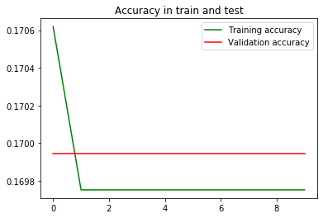
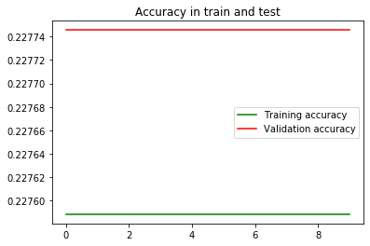
The ignorance of my model
ADAM
SGD
Why my model does not learn?
Empirical research 2019/2020
10

Slide 11
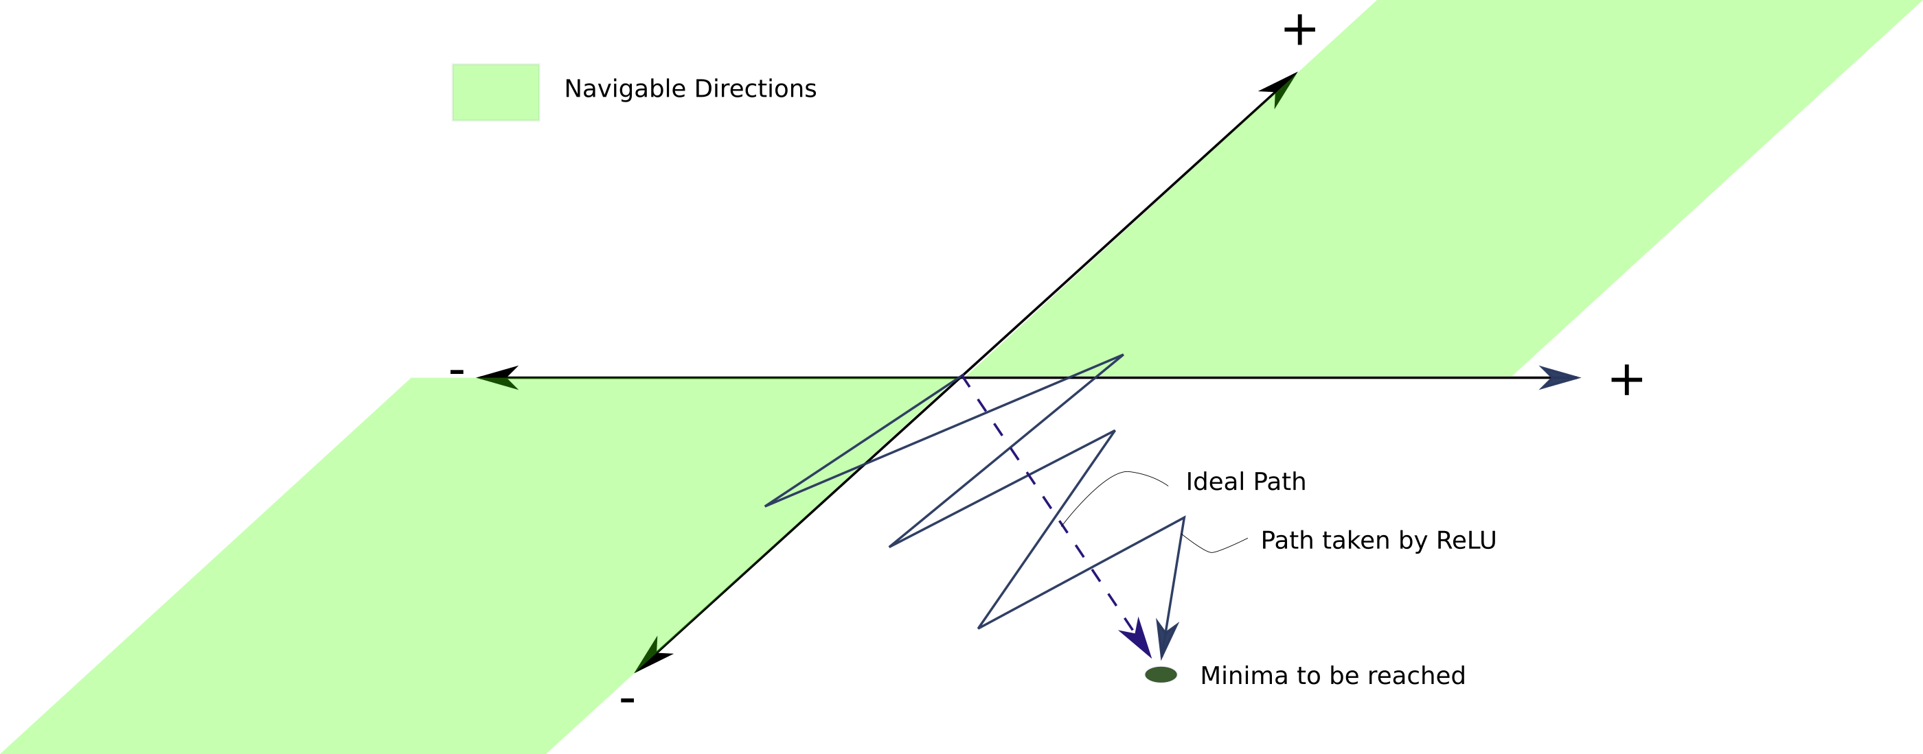
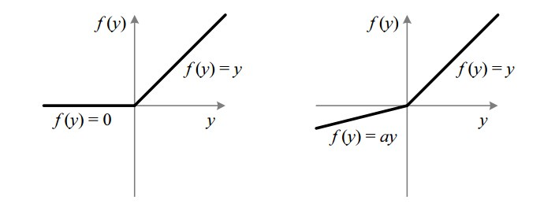
From Relu to Leaky Relu
1
Relu is linear for all positive values, and zero for all negative values.
2
PROBLEM: “dying Relu”
The weights and the bias causing the negative preactivations cannot be updated.
3
SOLUTION: Leaky Relu
The backward pass is able to alter weights which produce a negative preactivation as the gradient of the activation.
Y= max (0; x)
Y= max (0.01x; x)
“Delving Deep into Rectifiers: Surpassing Human-Level Performance on ImageNet Classification”, Kaiming He et al. (2015)
11

Slide 12
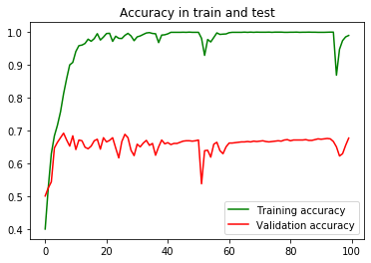
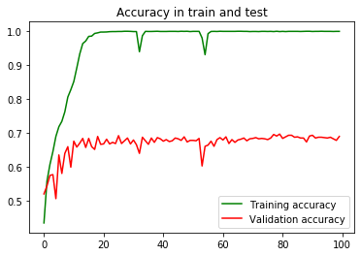
Which algorithm to use? (1)
L.r: 0.001
98% accuracy in the training set
vs 68%.
Adaptive Moment Estimation (Adam)
It chooses a direction that would lower the error rate, and continue iterating until the objective function converges to the minimum.
Learning rate:
L.r: 0.0001
99% accuracy in the training set vs 70%.
0.01
0.001
0.0001
0.00001
Empirical research 2019/2020
12

Slide 13
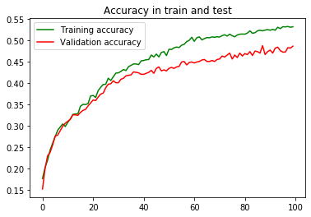
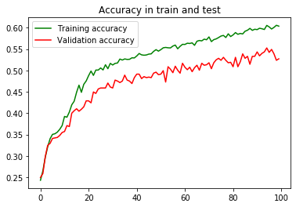
Which algorithm to use? (2)
Stochastic Gradient Descent (SGD)
It does not perform computation on the whole dataset but only on a small subset or random selection of data examples.
L.r: 0.001
Momentum:0.5
53% accuracy in the training set vs 48%.
Learning rate:
0.01
0.001
0.0001
0.00001
L.r: 0.0001
Momentum: 0.9
60% accuracy in the training set
vs 52%.
Momentum:
To improve the stability, the convergence and the speed of the training.
0.5
0.9
Empirical research 2019/2020
13

Slide 14


Which
algorithm
to use? (3)
ADAM
Best model:
Learning rate 0.0001
SGD
Best model:
Learning rate 0.0001
Momentum 0.9
SGD has less overfitting, thus i decide to use it!
14

Slide 15
Section 3
MODEL IMPROVEMENTS

Slide 16
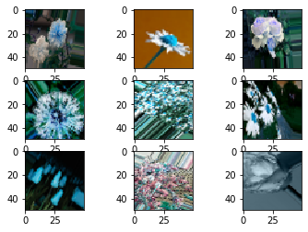
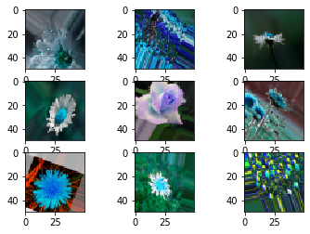
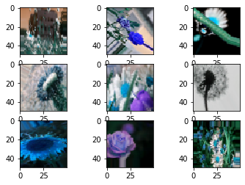
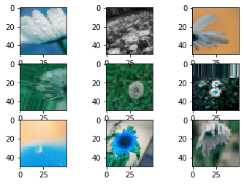
Avoiding overfitting: data augmentation (1)
Flipping the image
horizontally
Rotation
Rotation of the image of 40°.
Width shift
2
Shifting the image
horizontally by 20%.
Height shift
Shifting the image vertically
by 20%.
Zoom
Zooming the image of 30 %.
"Imagenet classification with deep convolutional neural networks" (2012), Krizhevsky Alex, Ilya Sutskever and Geoffrey E. Hinton.
16

Slide 17
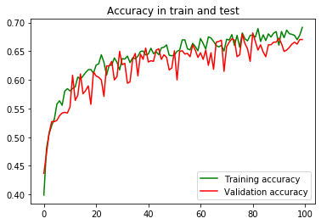
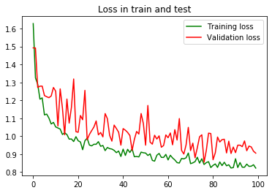
Avoiding overfitting: data augmentation (2)
69% accuracy in training set and 67% in test set
No more overfitting but the learning is unstable!
Empirical research 2019/2020
17

Slide 18
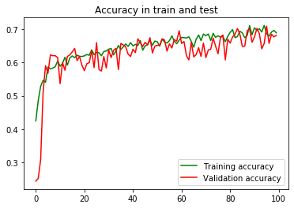
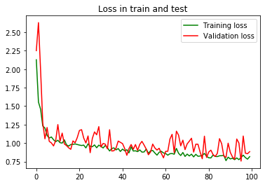
Increasing the stability:
Batch normalization (1)
Not a large improvement:
Improvement of stability and performance
69% accuracy in training set and 68% in test set.
It normalizes the output of the previous activation layer by subtracting the batch mean and dividing by the batch standard deviation.
After each convolutional layer
"Batch Normalization: Accelerating Deep Network Training by Reducing Internal Covariate Shift" (2015),
Ioffe Sergey, Szegedy Christian
19

Slide 19
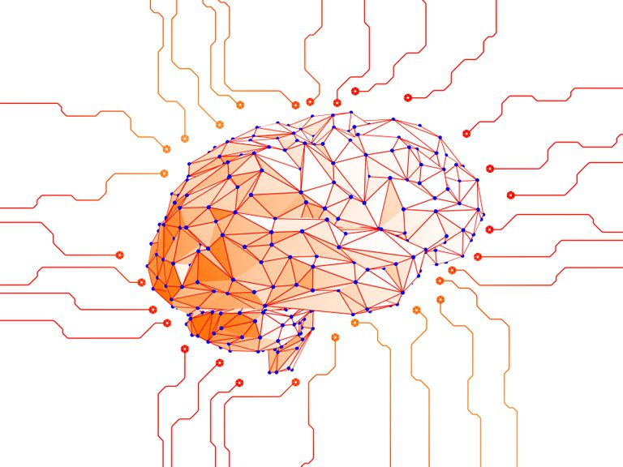
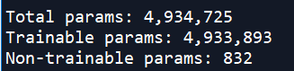
Final model
SUMMARY:
Optimizer: SGD with 0.0001 as learning rate and 0.9 as momentum;
Activation functions:
Leaky Relu in the hidden layers
Soft Max in the output layers
Categorical cross-entropy as loss function;
32 as batch size and 100 epochs;
Data augmentation + Batch normalization;
Empirical research 2019/2020
20

Slide 20
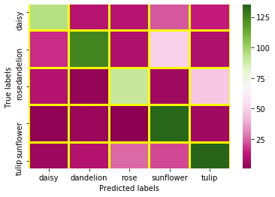
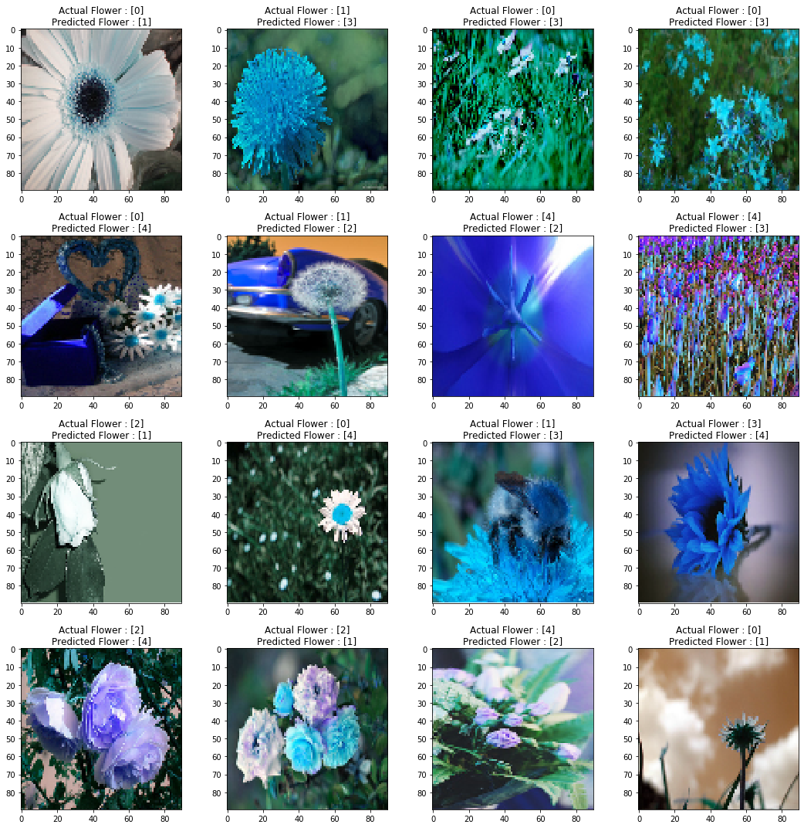
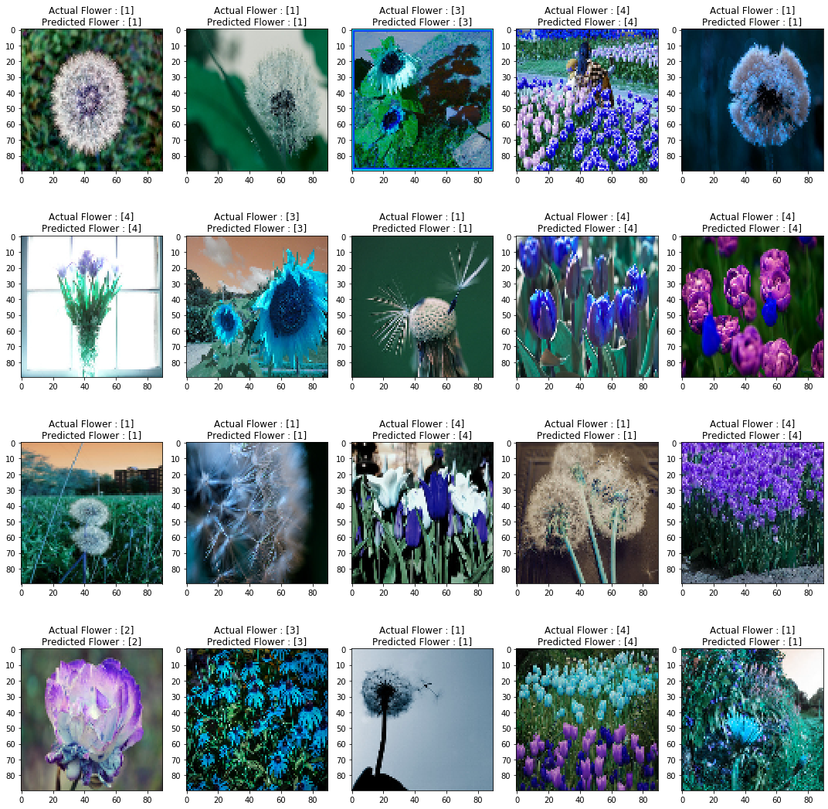
Prediction
580 correct classification (67%)
285 uncorrect (33%).
95
11
11
23
14
17
125
9
50
9
10
3
91
6
47
2
4
1
134
6
5
10
26
21
135
Empirical research 2019/2020
21

Slide 21
Section 4
WHAT ELSE?

Slide 22
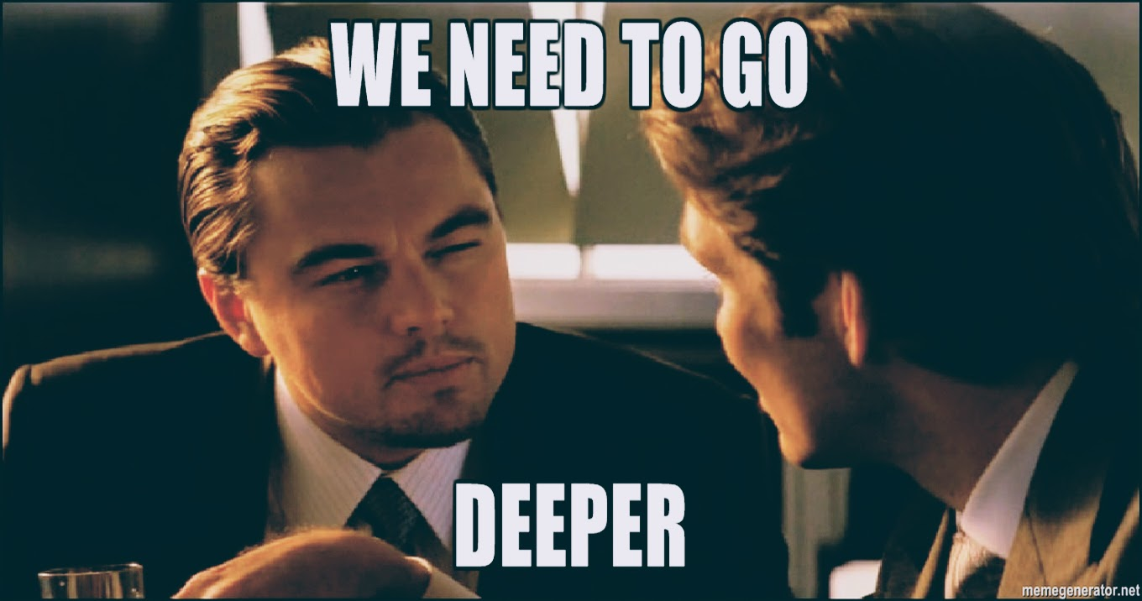

Slide 23
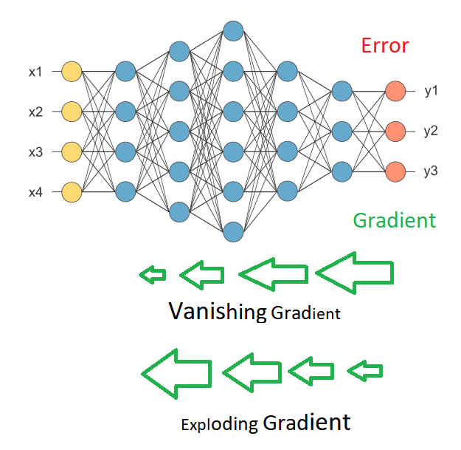
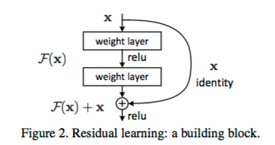
Adding complexity
Increasing the depth to increase the “levels” of features: higher accuracy
MAIN PROBLEM:
Vanishing/exploding gradient
HOW TO SOLVE IT?
Empirical research 2019/2020
23

Slide 24
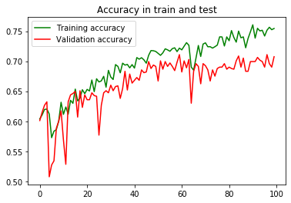
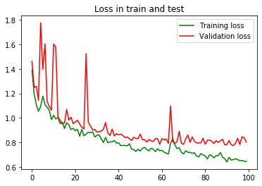
ResNet-50
It is trained on more than a million images from the ImageNet database.
He initializer, batch normalization, no dropout.
Mitigation of vanishing gradient problem because of skip connections.
Skip connections are extra connections between nodes in different layers of a neural network that skip one or more layers.
It reuses activations from a previous layer until the adjacent layer learns its weights.
75% accuracy in training set and 69% in test set.
«Deep Residual Learning for Image Recognition», 2015, Kaiming He, Xiangyu Zhang, Shaoqing Ren, Jian Sun
24

Slide 25
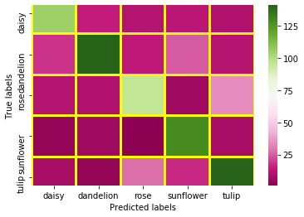
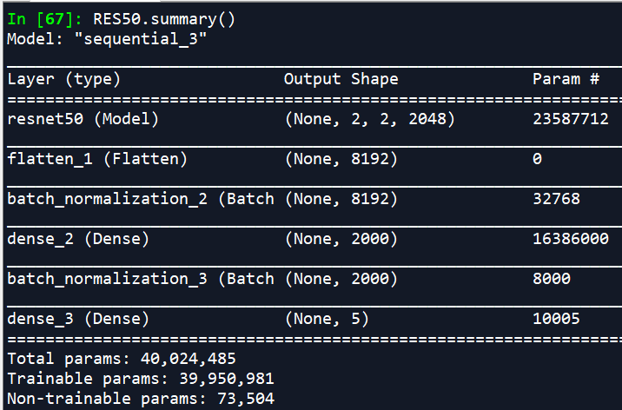
Prediction
620 correct classification (72%)
245 uncorrect (28%).
105
15
11
13
10
19
141
14
25
11
11
10
96
6
34
3
6
1
129
8
8
3
28
17
141
We have not a strong improvement. Why?
Too much parameters to estimate and few images.
Because of the large number of weights that are not updated durign the train.
Empirical research 2019/2020
25

Slide 26
Section 5
CONCLUSION

Slide 27
Conclusion
Not always deeper is better : Resnet-50 is very complex and it works well for large dataset:
In this case is better to work with «customized» model.
Try different combination and structures: average pooling, Adam optimizer, more/less convolutional layers etc.
Use of cv to find the best parameters ( learning rate, batch size, number of epochs, optimizer..)
Use of GPU: maintain the original size.
Empirical research 2019/2020
27

Slide 28
References
Chollet François (2017), «Deep learning with Python»
Ioffe Sergey, Szegedy Christian (2015), "Batch Normalization: Accelerating Deep Network Training by Reducing Internal Covariate Shift"
Kaiming He et al. (2015), Deep Residual Learning for Image Recognition»
Kaiming He et al. (2015), “Delving Deep into Rectifiers: Surpassing Human-Level Performance on ImageNet Classification”
Krizhevsky Alex, Ilya Sutskever and Geoffrey E. Hinton (2012), "Imagenet classification with deep convolutional neural networks"

